Slide 1

Project Sun
SEN4015 – ADVANCED PROGRAMMING WITH PYTHON
Dağhan Sever

Slide 2

Table of Contents
3
4
5
Motivation
Inspiration
Objectives
6
7-10
11
Problems
Systems & Architecture
Conclusion & Future Work

Slide 3
Motivation
Previous Experience
Familiarity with game development made a game project a natural starting point.
Multidisciplinary Nature
Game development combines logic, design, and systems thinking, which keeps the work engaging.
Prototype Buildup
The idea of this project had potential to serve as a prototype for a larger, future project.
3

Slide 4
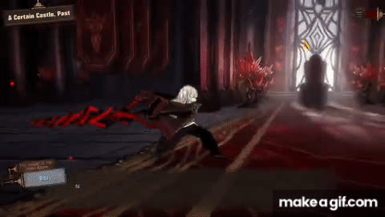
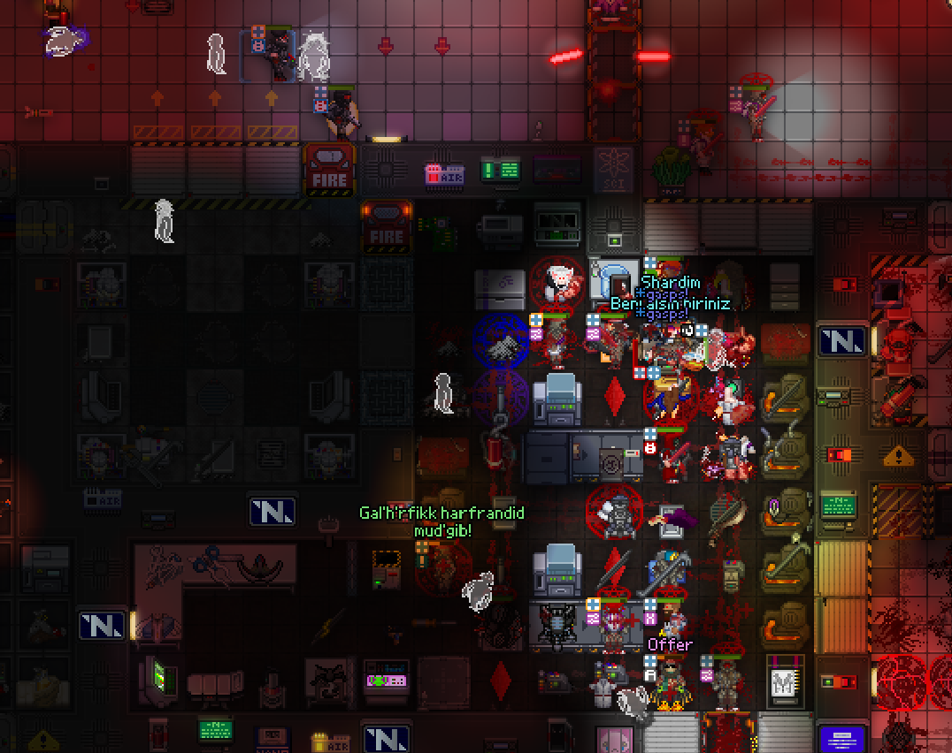
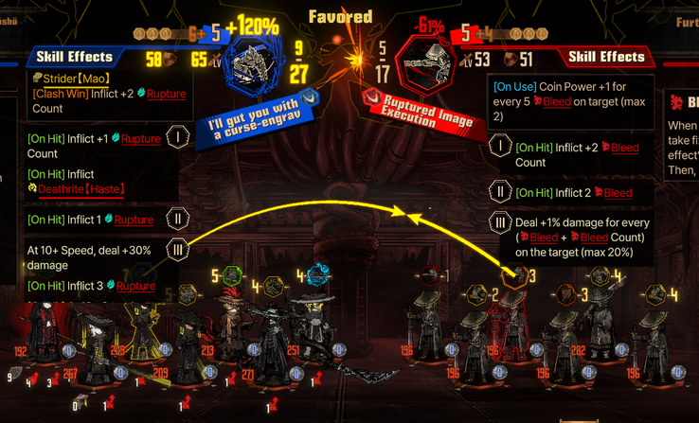
Inspiration
4

Slide 5
Objectives
Develop a turn-based combat system in Python
Create a scalable and modular prototype structure for future expansion
Implement core gameplay flow from story to combat
5

Slide 6
Problems
1
Inexperience in pygame library
2
Assessing project scope
3
Unexpected time sinks
Complexity of transitioning from finalized design to implementation
4
6

Slide 7
Architecture
game.py
renderer.py
character.py
Encounter Class
Skill Class
Assets
7

Slide 8
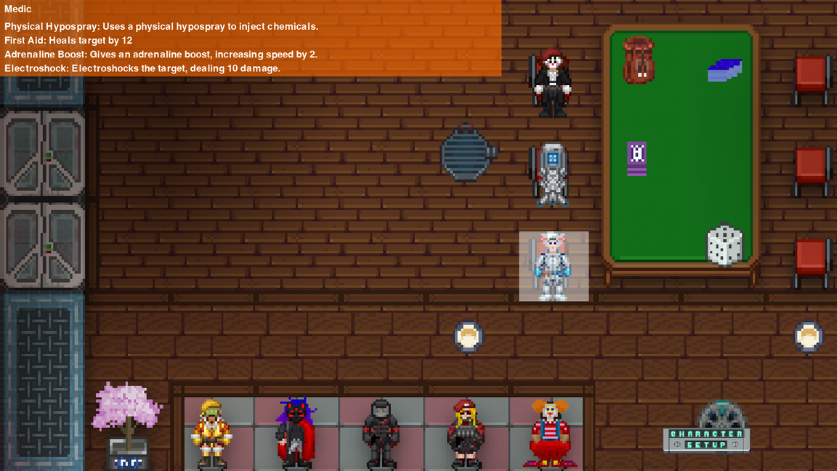
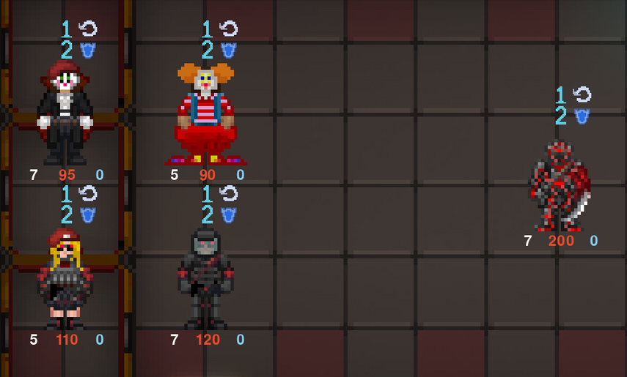
game.py
1
Initialization
2
Event System
3
Advancing Game State
8

Slide 9
renderer.py
1
Rendering
4
Turn System
2
Collision Handling
5
Encounter Class
3
Actualizing Skill System
9

Slide 10
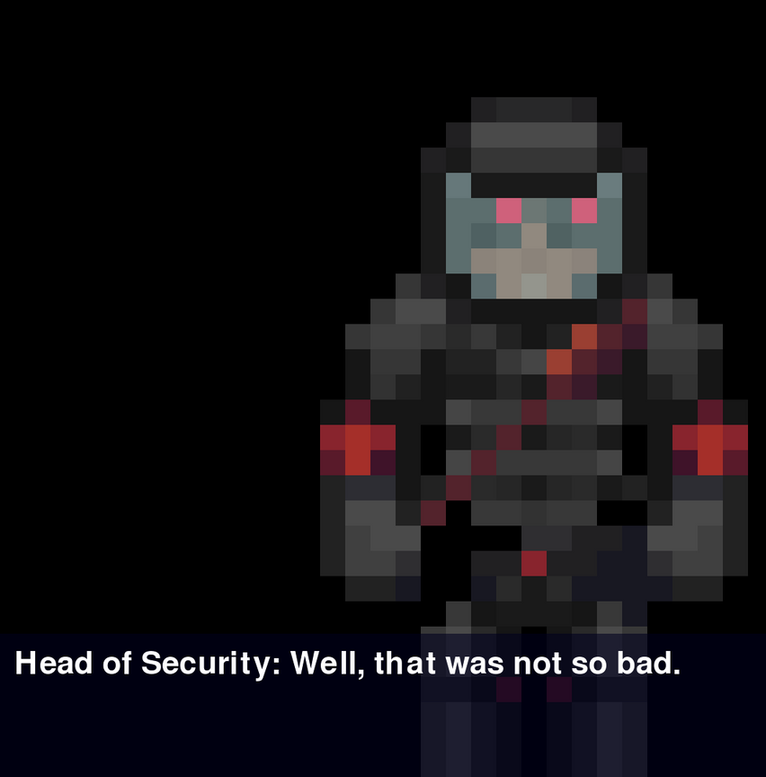
character.py
1
Character Class
2
Skill Class
3
Skill Functions
10

Slide 11
Conclusion
Results
Future Work
Conclusion
Fully playable turn-based game prototype
Object-oriented, mostly modular web of systems. Any of which could be separated to be used elsewhere.
Tutorial
Animation System
Improved Skill System
Enhanced Enemy AI
Project objectives were successfully met
Prototype provides a strong foundation for expansion
Design tradeoffs were appropriate for project scope
11

Slide 12
The End
THANK YOU FOR LISTENING
Dağhan Sever

